Slide 1

Elva Services
Elva Teenused
Krista Loog
Manager of the institution

Slide 2
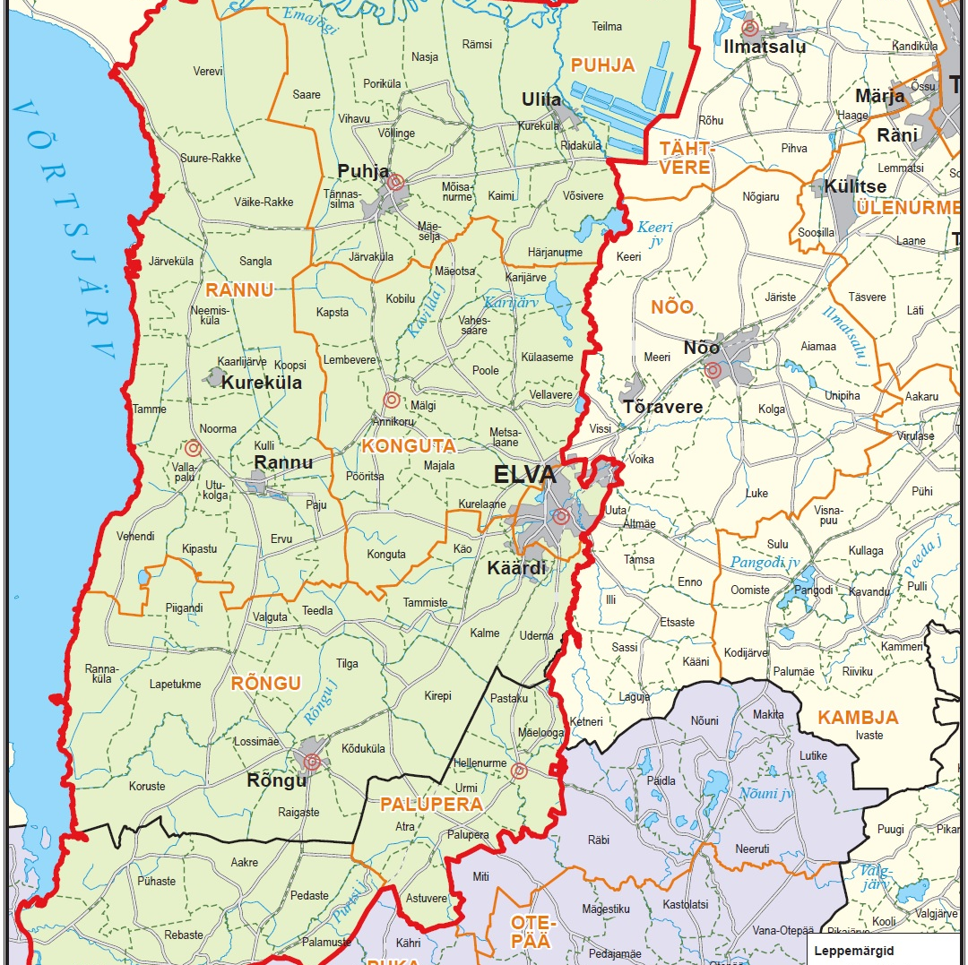
Elva Vald
Elva Municipal Government
732 square kilometers
Elva municipality approx. 15 000 residents
Elva city approx. 5700 residents
7 general educational schools (2 gymnasium)
6 kindergardens
approx. 2500 childern

Slide 3

Elva Services
  Established in 2018 by Elva municipality council.
  Purposes
  organize catering in the educational institutions
  manage and maintain the buildings and facilities
  7 schools and 6 kindergartens (84 employees, 35 in catering)
  about 2500 children + employees
Notes:
Real Estate Management
Our institution was established in 2018 by Elva municipality council. The purpose is to organize catering in the educational institutions of Elva municipality, based primarily on the principles of healthy and local use of raw materials, and to manage and maintain the buildings and facilities.
In our municipality we had bad experiencese before with private company caterer. So the municipal covernment decided to create managed institution their own.
We have 84 employees and 35 of them work in 11 kitchens. From 4 kitchen we organize food transport to educational institution, where we dont have kitchen.
We cater to schools and kindergartens of very different sizes. The schools has the fewest 28 students and the largest 960 in two different schoolhouses.
In total, we offer catering for 2,500 children in Elva municipality.

Slide 4
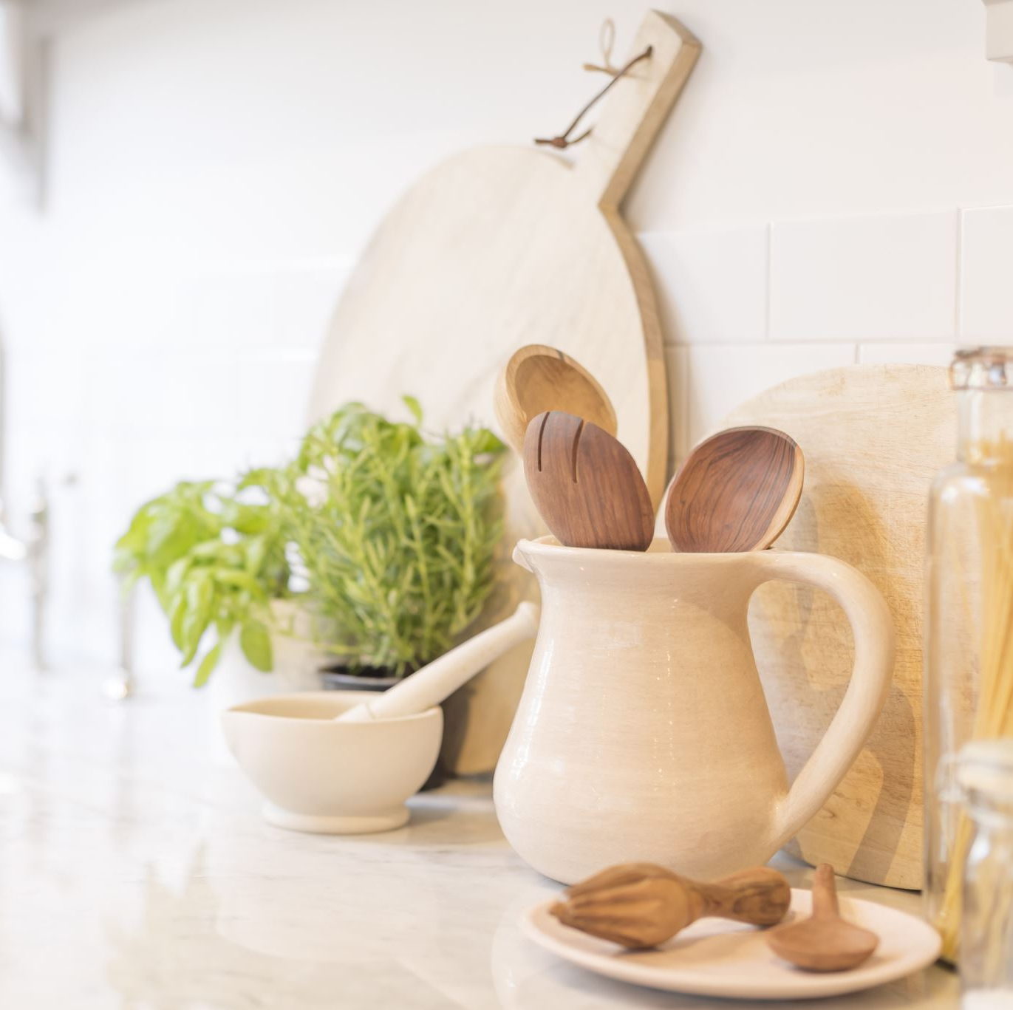
Menus
  ANC catering and warehouse programm – recipes, technological cards, macronutrients, delivery notes, price per meal and per children.
  2 kitchen managers over the municiplaity – menus, leading personal, everyday questions, catering arrangements, purchase of equipment, inserting delivery notes and catering program organizing, inspection of raw materials etc.
  Cook in kitchen – making orders, completing the self-control plan, responsible for on-site food.
Notes:
Macronutrients – fat, carbs, proteiin
Delivery notes – all primary goods

Slide 5
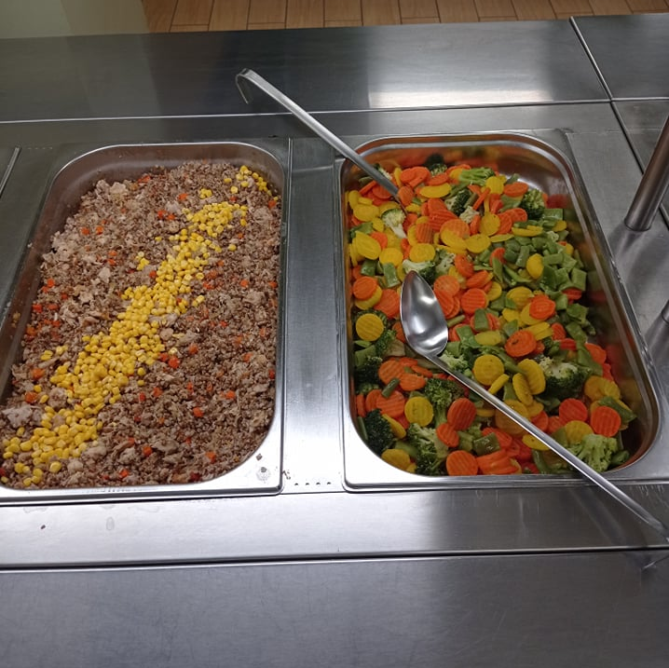
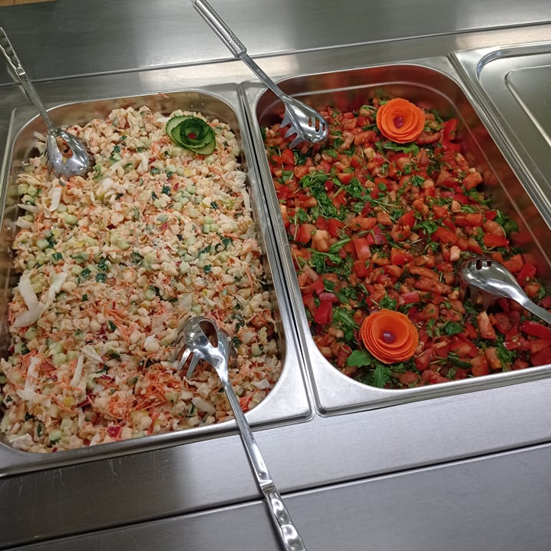
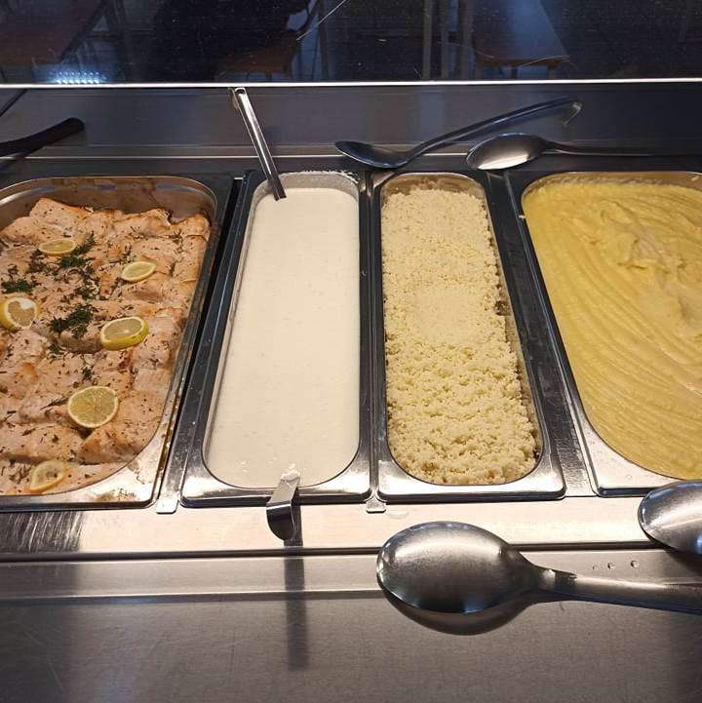
Meals
School
8 – 9 am breakfast
porridge
School lunch
Kindergarten
Morning 8:30
Lunch 12:30
Light dinner 15:30
Notes:
In schools, we offer breakfast porridge (free for student), which is available from 7,30 am to 9 am, school lunch (90 cents for parent) and in some school aftermeal (free) for children who stay at school until going home of training. Total 2.80€
In kindergartens we offer food three times a day - morning (8.30), lunch (12.30) and dinner, which is light food before going home (15.30). Parent pays 2.50€. Total 5,5€

Slide 6
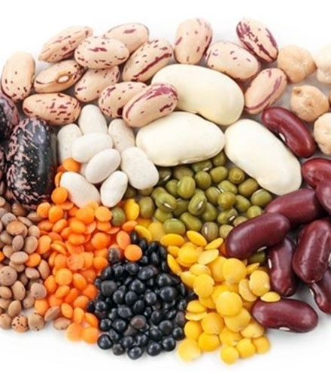
Menu
Health protection requirements for meals in pre - school institutions and schools (2008)
New regulation comes in 2025 summer
increase the quantities of vegetables and fruit;
legumes must be offered weekly;
there must be at least one cereal meal a day in the kinderkarten;
the minimum quantity of nuts and seeds shall be determined
the amount of meat and milk in the menu is reduced
so on.
Estonian food recommendations
„Taimne Teisipäev“ / „Plant based Tuesday“ 2020
Agricultural and Food board, Health board
Notes:
Our menu must comply with the Public Health Implementing Act: Health protection requirements for meals in pre-school institutions and schools (2008).
We hope that a new regulation will be adopted next year - requirements for meals in educational institutions, which will make children's food table even healthier.
The old regulation is obsolete and needs to be replaced a long time ago.
The new regulation will increase the quantities of vegetables and fruit; legumes must be offered weekly; there must be at least one cereal meal a day in the kinderkarten; the minimum quantity of nuts and seeds shall be determined, the amount of meat and milk in the menu is reduced and so on.
We also follow the Estonian food recommendations, which have been prepared in co-operation with the Nordic countries. It will be updated in the near futuure too!
We have been members of the Taimne Teisipäev or plant based Tuesday since 2020, and one day a week we have a meat-free day or plant based lunches. This balances the menu and offers more opportunities to eat healthy food.

Slide 7
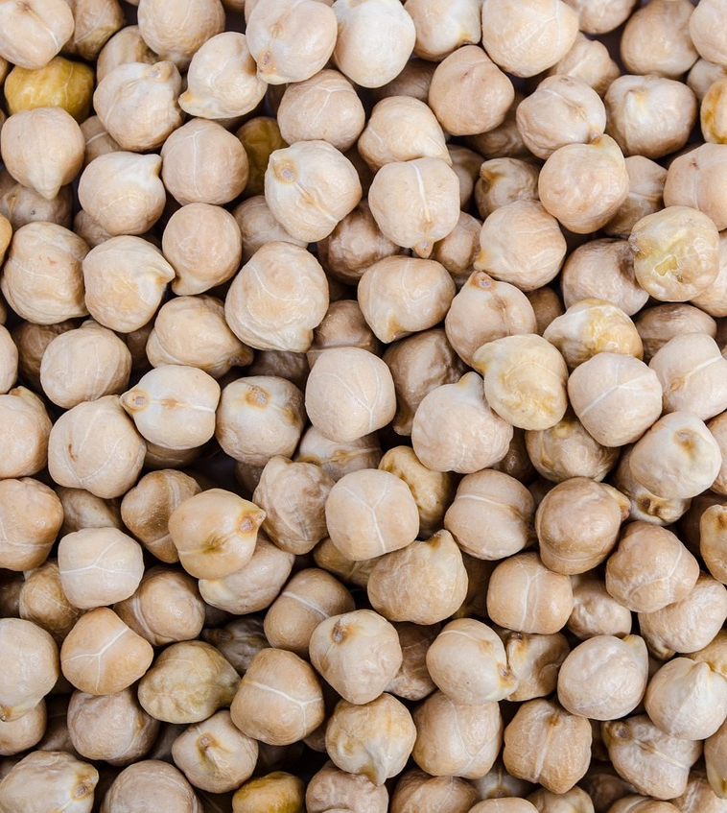
Public procurement
Public Procurement act – very rigid
  We buy foodstuff
  several criterias - shelf life, appearance, compliance with the requirements of the delivery of the goods, legislation, time of delivery, etc
Buy food around 400 000€ a year
Principle to use healthy and local use of raw materials
Local food from Elva Municipality – vegetables, fruits, juices, jams, honey, chickpeas, lentils so on.
Sales contracts
Notes:
We buy in food for around EUR 400 000 a year, which is why we are obliged to carry out public procurement.
In public procurement, we cannot favor anyone, but we must be able to make the documents as correct as possible in order to obtain the highest possible quality goods. We have largely been able to do that today.
The Estonian public procurement law is very rigid. It is not possible for us to give preference to local raw materials through procurement.
We use local vegetables, fruits, juices, jams, honey, chickpeas, lentils and so on. We buy local food within the possible amount, which is 40,000.

Slide 8


Organic food
Started in March
Difficult to buy, very little raw material
Smaller companies cannot (difficult, few knowledges) participate in the public procurement
We buy milk, kefir, some vegetables, different flours and flakes, eggs etc.

Slide 9
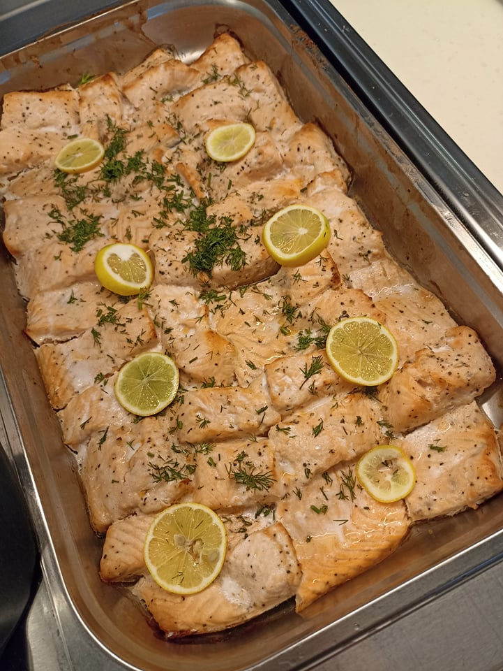
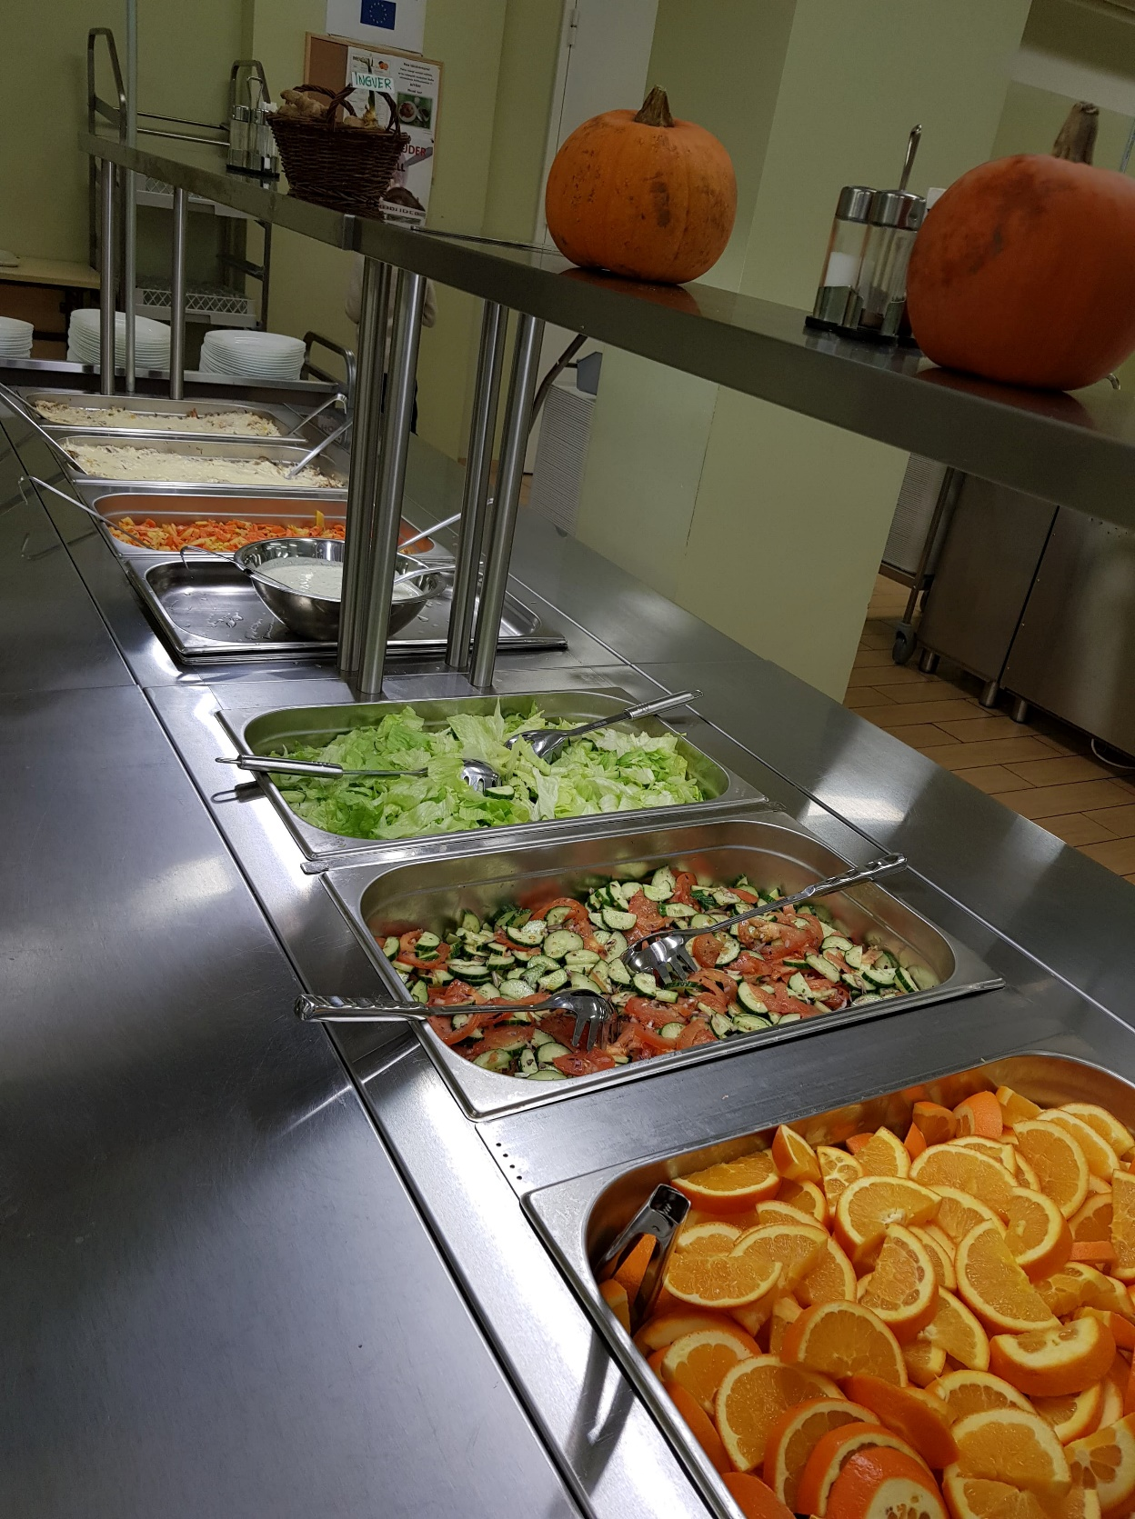
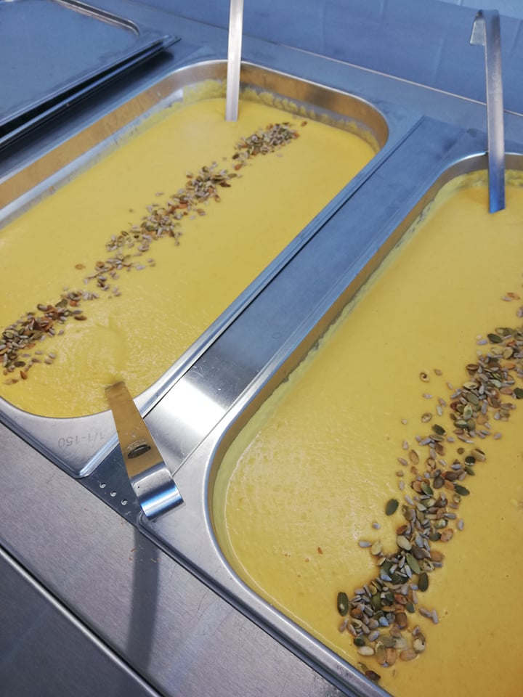
Pictures of catering in schools

Slide 10
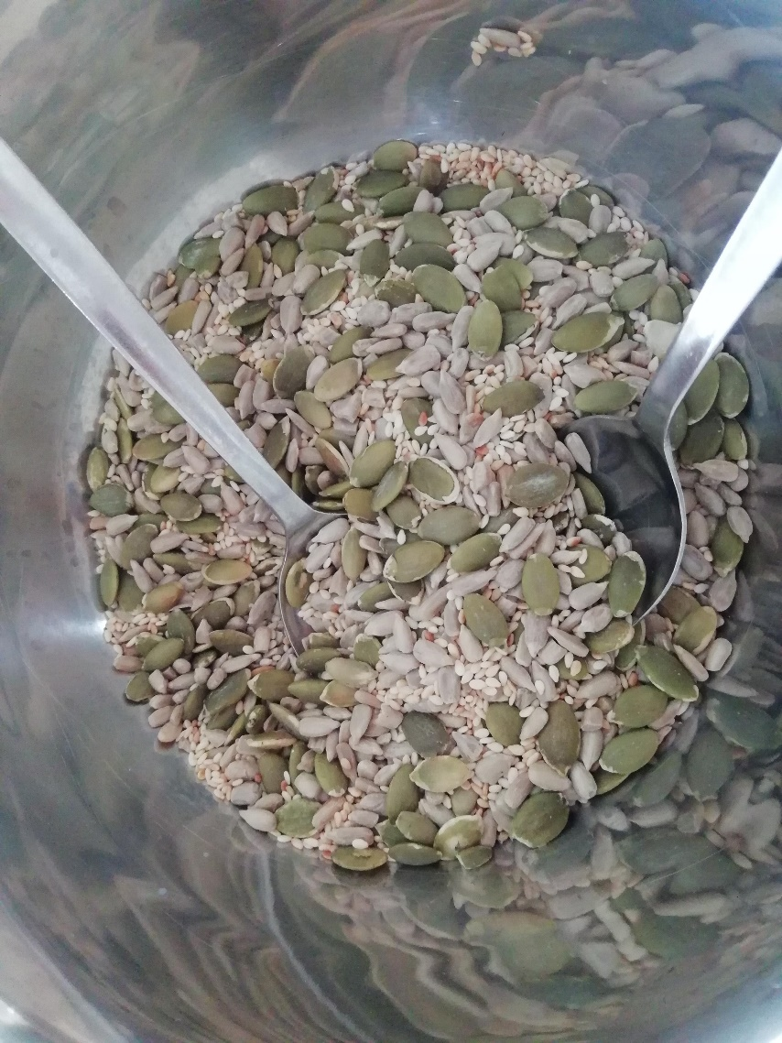
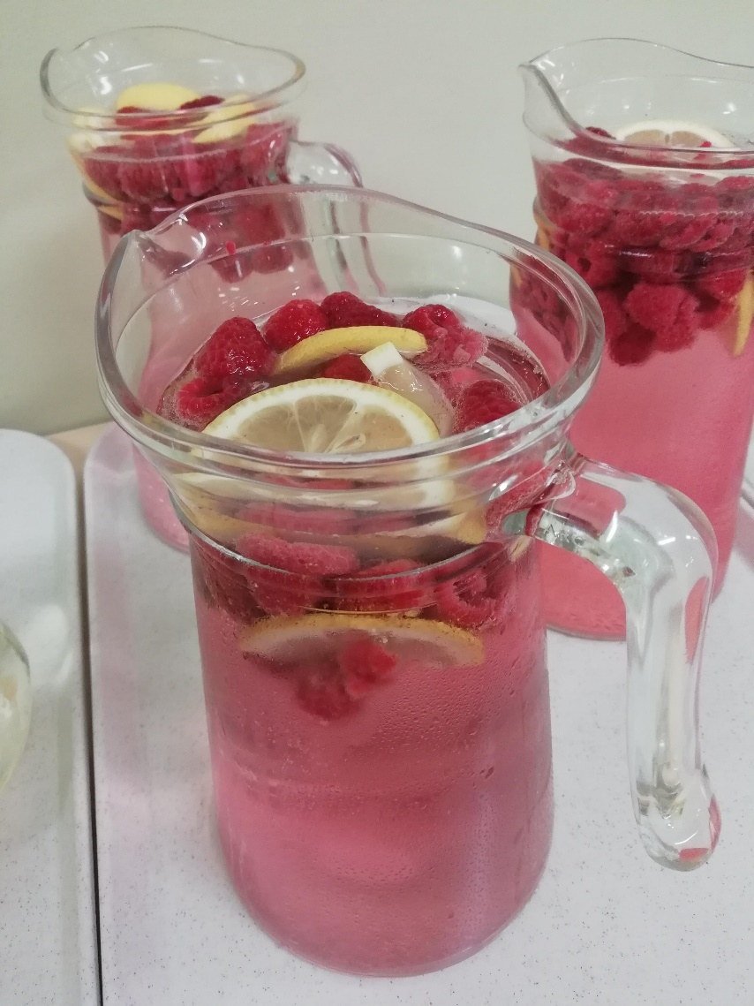
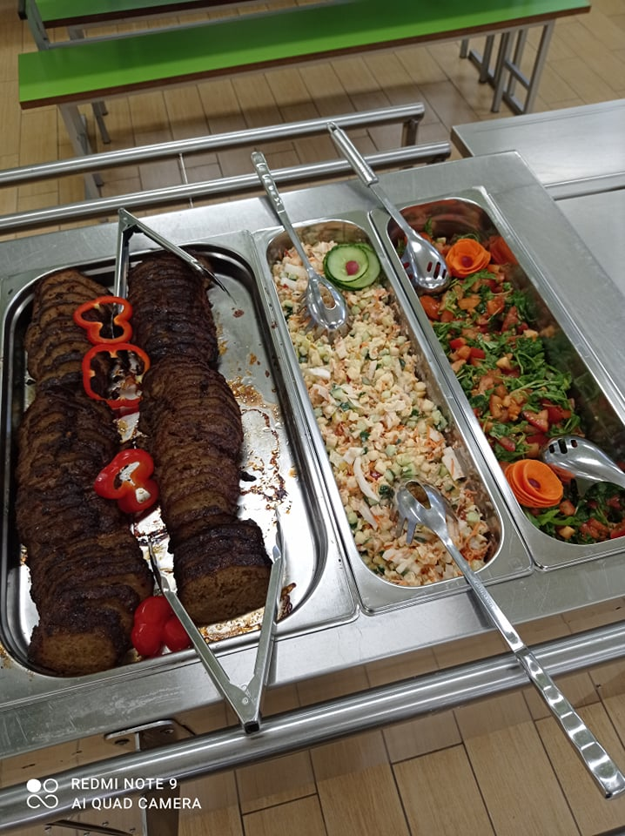
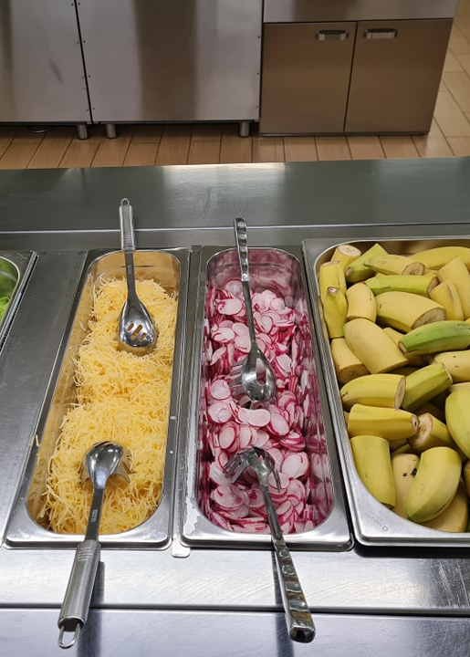
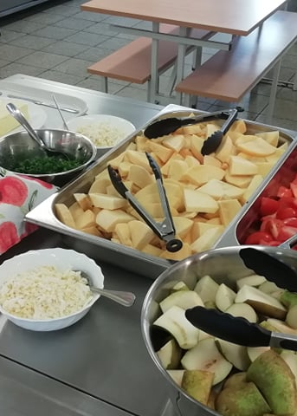
Pictures of catering in schools

Slide 11
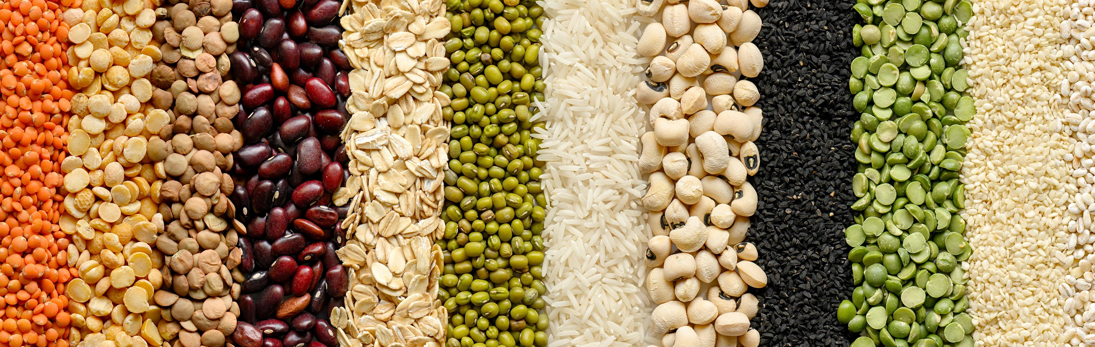
Thank you!
Krista.Loog@elva.ee
elvateenused.ee

